Slide 1
Brazil Experience: Active toxicity monitoring in adults and birth defect surveillance with DTG
Country Experience in Monitoring New ARVs: Focus on Toxicity Monitoring and Surveillance of DTG during pregnancy to inform treatment policy
Adele Schwartz Benzaken
Department of STI, HIV/AIDS and Viral Hepatitis
Ministry of Health of Brazil

Slide 2
No conflict of interests

Slide 3
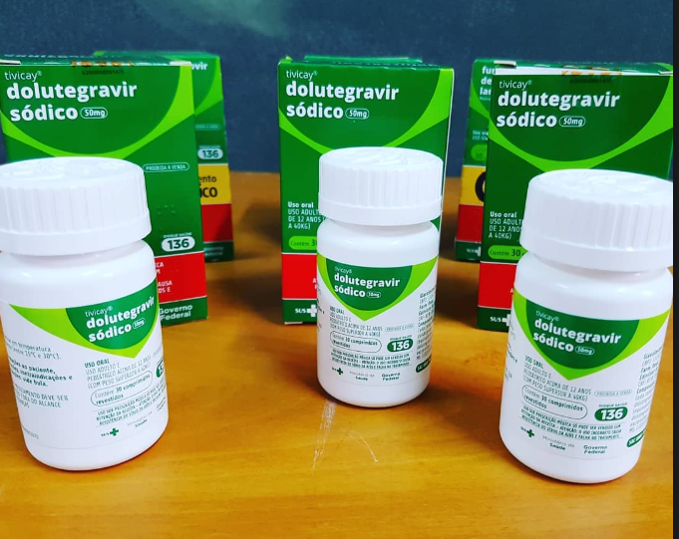
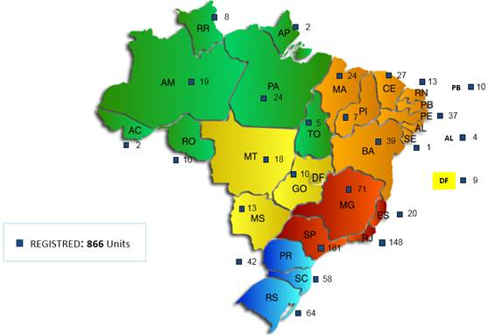
The Brazilian Experience of Implementing Active Pharmacovigilance of Dolutegravir
In Jan 2017, the MoH began to recommend DTG for ART initiation and 3rd line therapy;
Active DTG pharmacovigilance was simultaneously implemented using patient interviews and an online questionnaire from Brazil’s preexisting Medication Logistics Control System (SICLOM) at the ARV dispensations units;
It was designed to improve knowledge on DTG adverse events.
Total ARV dispensations units: 866

Slide 4
The Brazilian Experience of Implementing Active Pharmacovigilance of Dolutegravir Results
April 2017 to June 2018
132,931 PLHIV used DTG, 113,170 reported
113,170 reported, 2,178 presented at least one AE
85% coverage
1.9% had AE
Total reported adverse events: 3,639
Source: MoH Brazil

Slide 5
The Brazilian Experience of Implementing Active Pharmacovigilance of Dolutegravir
The system is able to monitor toxicities related to any ARV
Adverse Events identified in Brazil are similar to those reported in clinical trials and international pharmacovigilance data.
The pharmacovigilance of DTG was not outlined to evaluate its safety for pregnant women or women of childbearing age.

Slide 6
Brazilian Rapid Response - Review of Recommendations
May 18th, 2018 (same date as WHO)
WLHIV of childbearing potential age:
Should receive DTG with effective contraceptive method (i.e. IUD; hormonal implant)
Pregnant WLHIV (initiating ARV):
EFV or ATVr if <14 weeks of pregnancy
RAL if ≥14 weeks of pregnancy
Women of childbearing potential age and PEP:
Should NOT receive PEP with DTG
Indication: ATV/r

Slide 7
Initial Findings – Pregnant WLHIV DTG Exposed - Brazil, 2018
Distribution WLHIV with pre-conception exposure to DTG (Jan 2017 – May 2018) after National database linkage:
All 27 states
204 municipalities
491 cases
Outreach: phone calls and quick questionnaire (local programmes)
Preliminary Results
Outcome | N | %
Live birth | 91 | 53.8
Stillbirth | 2 | 1.2
Abortion | 8 | 4.7
Still pregnant | 68 | 40.2
Total | 169 | 100
No neural tube defects identified
Source: MoH- Brazil

Slide 8
Dolutegravir and pregnancy outcomes among ART-recipients in Brazil: a national population study
Partnership: MoH-Brazil/Fiocruz/Vanderbilt U/NIH
Funding: MoH – Brazil/NIH
Goals:
Goal #1: To estimate the risk of neural tube defects in infants born to women receiving DTG- and RAL vs. non-DTG-containing ART regimens at the time of conception.
Goal #2: To evaluate patient´s data and associated factors with risk of neural tube defects in infants born to WLHIV on DTG-containing regimens at time of conception.
Study design:
#1. National registry linkage and case-control
#2. Observational cohort

Slide 9
Observational Cohort Study
Retrospective, observational cohort study with all WLWH exposed to DTG during conception and inclusion of WLWH on non-DTG based ART at the time of conception (1:3)
Matched by age at pregnancy and prenatal clinic site
Outcomes:
Iniencephaly, Anencephaly, Encephalocele, Meningocele, Myelomeningocele, and Spina bifida (clinical or radiographic diagnosis)

Slide 10
Observational Cohort Study
Demographic information
Medical history (including HIV)
Behavioral data (including alcohol, tobacco and drug use)
Obstetric history
Antenatal care data (including folic acid supplementation)
Laboratory results (including serologies)
US exams
Pregnancy outcomes
HIV clinic
RedCap
Antenatal clinic
Maternity
Data collection from medical records and health systems
CD4 cell count and VL → SISCEL (Brazilian System)
ART regimens → SICLOM

Slide 11
Next steps
As a public health emergency, researchers and public health institutions in Brazil are committed to timely and efficient execution of the proposed study:
Ethical committee approval
Hire 70 reviewers research personal (to work in the field)
Protocol training in the first week of August
Activities in the field expected to start by end of August
Complete analyses of observational cohort study
Present and prepare results for publication and dissemination

Slide 12
Thank you!

